Slide 1
R
Matrix ( Theory and R code )

Slide 2
In mathematics, a matrix (plural: matrices) is a rectangular array^{[1]} of numbers, symbols, or expressions, arranged in rowsand columns.^{[2][3]} For example, the dimensions of the matrix below are 2 × 3 (read "two by three"), because there are two rows and three columns:

Slide 3

2 X 3 ( 2 by 3 Matrix)
elements or entries

Slide 4
two matrices can be added or subtracted element by element If both are same size.

Slide 5
Multiply
two matrices can be multiplied only when the number of columns in the first equals the number of rows in the second
No of columns in First == No of Rows in Second

Slide 6
column vector
if v is a column vector (a matrix with only one column)

Slide 7
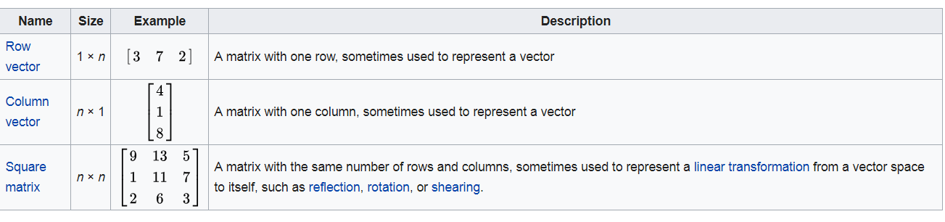

Slide 8
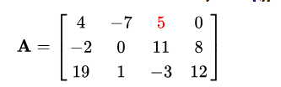
For example, the (1,3) entry of the following matrix A is 5

Slide 9
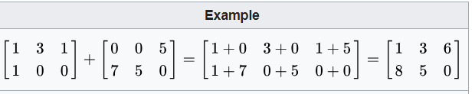
Addition

Slide 10
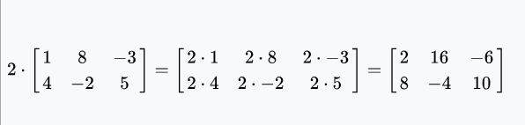
Scalar multiplication
2 X [ ]

Slide 11
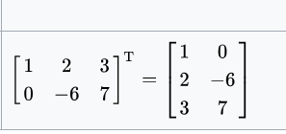
Transposition
The transpose of an m-by-n matrix A is the
n-by-m matrix A^{T} (also denoted A^{tr} or ^{t}A) formed by turning rows into columns and vice versa.
turning rows into columns and vice versa:

Slide 12
Multiplication of two matrices is defined if and only if the number of columns of the left matrix is the same as the number of rows of the right matrix. If A is an m-by-n matrix and B is an n-by-p matrix, then their matrix product AB is the m-by-p matrix whose entries are given by dot product of the corresponding row of A and the corresponding column of B:

Slide 13
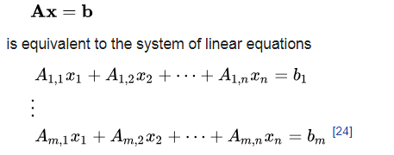
Linear equations

Slide 14
Diagonal and triangular matrix
Identity Matrix n-by-n matrix in which all the elements on the main diagonal are equal to 1 and all other elements are equal to 0, ( [1,0],[0,1]
Symmetric ( Square nxn)
Determinant

Slide 15
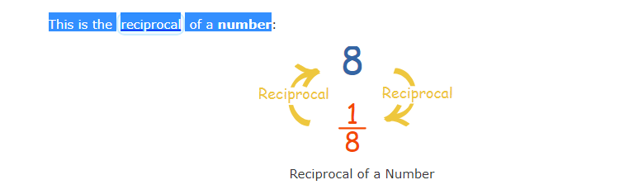
Inverse of a Matrix?
X -> 1/x

Slide 16
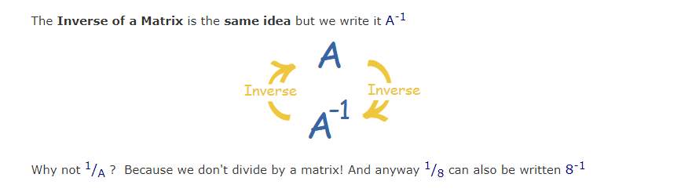

Slide 17
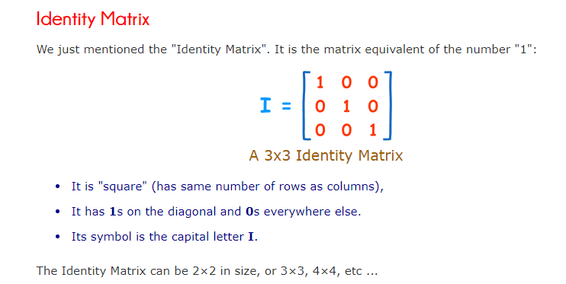

Slide 18
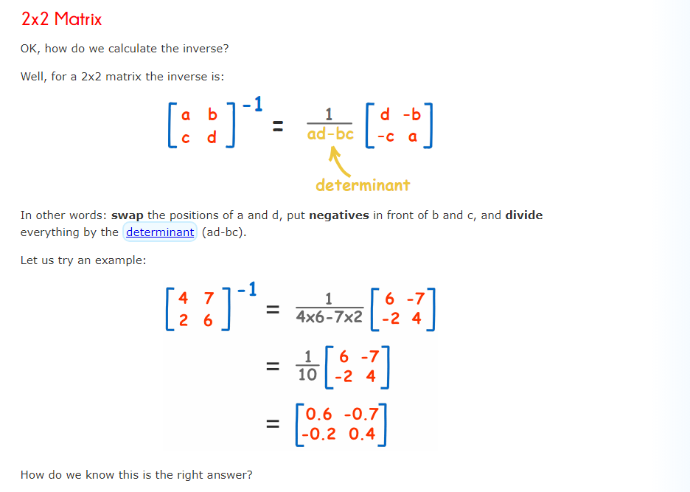

Slide 19
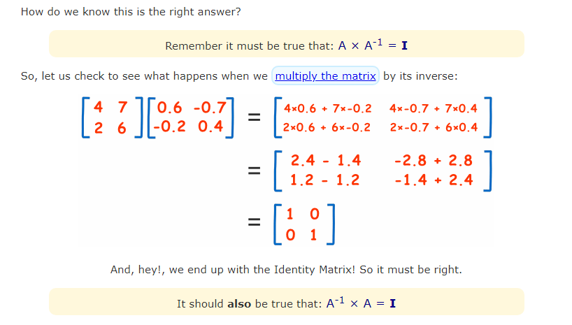

Slide 20
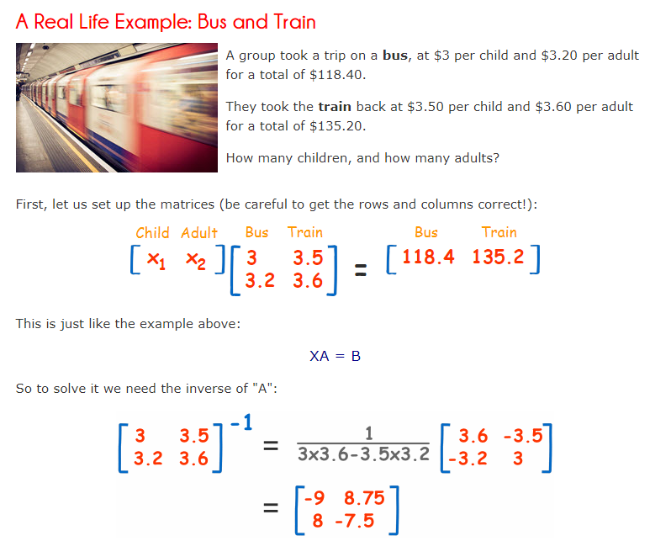

Slide 21
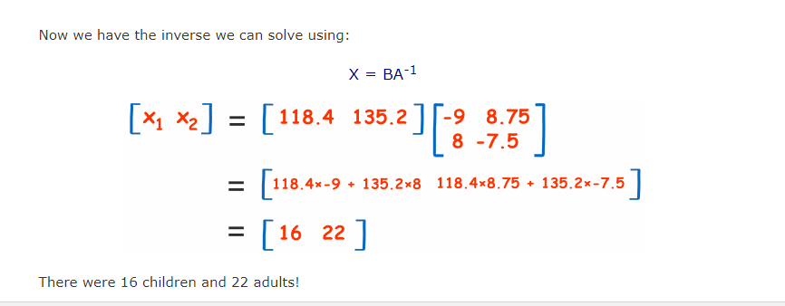

Slide 22
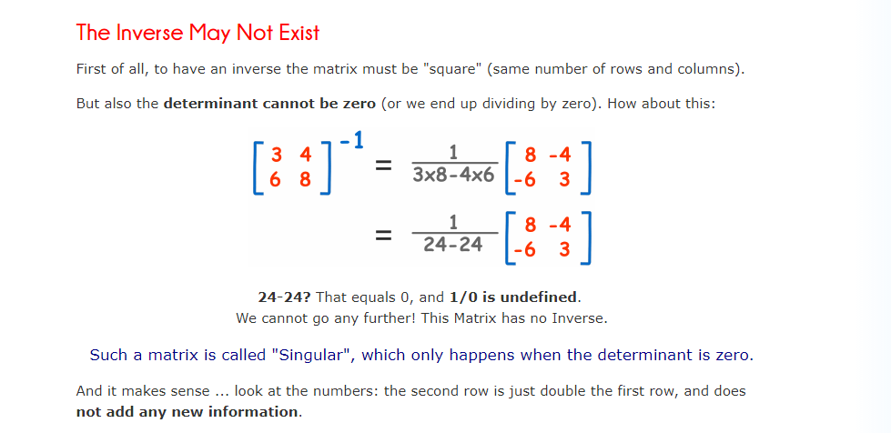

Slide 23
R code
# Elements are arranged sequentially by row.
M <- matrix(c(3,3.5,3.2,3.6), nrow = 2,ncol=2, byrow = TRUE)
print(M)
print(1/M)
# Inverse
print(solve(M))
print(det(M))
det(A) != 0, so inverse exists

Slide 24
# Access the element at 2nd column and 2nd row
print(M[2,2])
# Access only the 2st row.
print(M[1,])
# Access only the 2nd column.
print(M[,2])
print(M)

Slide 25
https://www.mathsisfun.com/algebra/matrix-multiplying.html
https://www.mathsisfun.com/algebra/matrix-inverse.html

Slide 26
A * B | Element-wise multiplication
A %*% B | Matrix multiplication

Slide 27
# Multiply X <- matrix(c(1,2,3,4,5,6), nrow = 2,ncol=3, byrow = TRUE) Y <- matrix(c(7,8,9,10,11,12), nrow = 3,ncol=2, byrow = TRUE) print(X) print(Y) print(X %*% Y)
print*(X * Y ) # wrong !!

Slide 28
Transpose
print(t(X))
T()

Slide 29
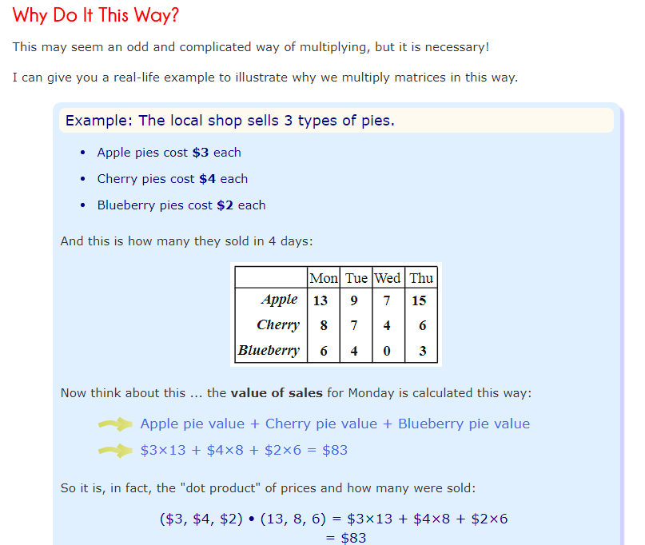
Multiply - Real

Slide 30
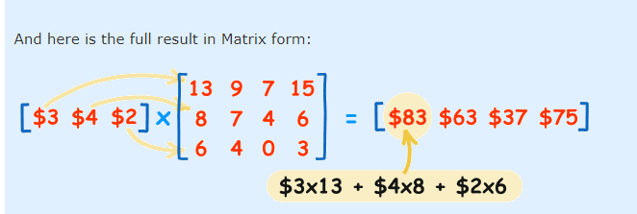

Slide 31
# print Multiply price = matrix(c(3,4,2),nrow=1,ncol=3,byrow=TRUE) sales = matrix(c(13,9,7,15,8,7,4,6,6,4,0,3), nrow=3,ncol=4,byrow=TRUE) print(price %*% sales)

Slide 32
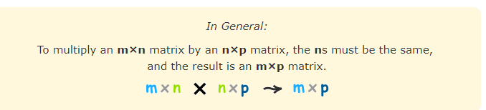

Slide 33
